Slide 1
Chap. 7 The MOSFET Amplifier
Signal Amplification
Actual MOSFET Characteristics
MOSFET Amplifier
Large Signal Analysis
Bipolar Junction Transitor (BJT)

Slide 2
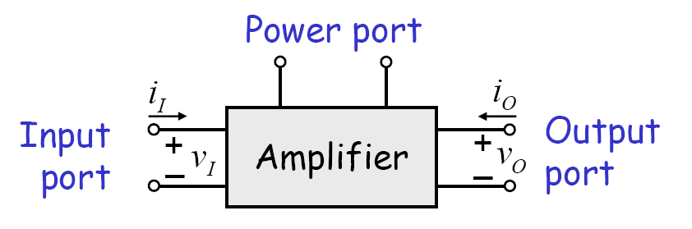
Signal Amplification
Amplifier: power gain
  noise tolerance
  buffering

Slide 3
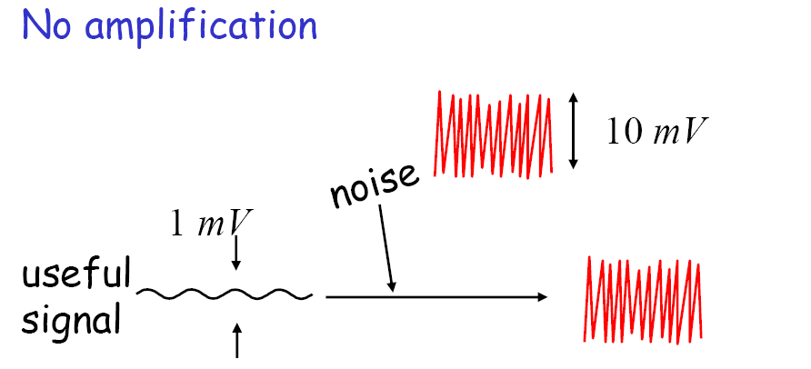
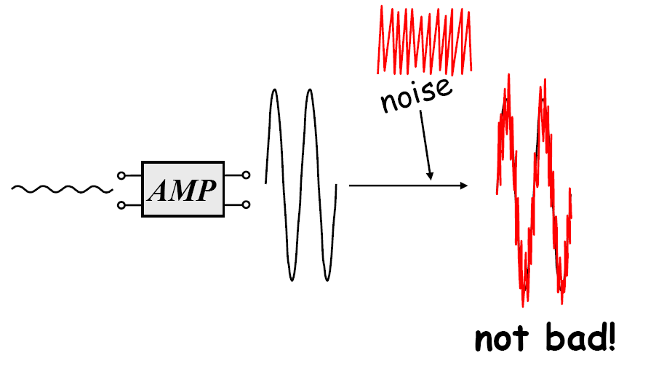
Why Amplify? (Analog)
Amplification

Slide 4
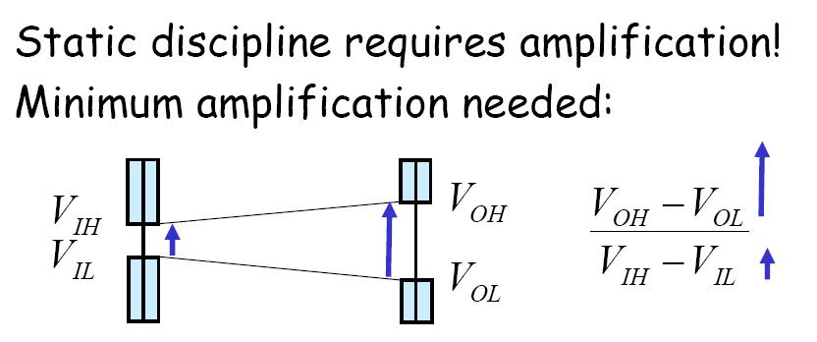
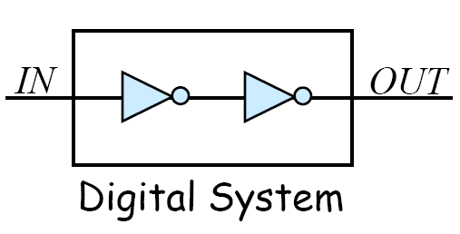
Why amplify? (Digital)

Slide 5







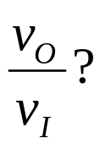
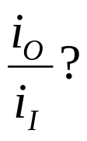
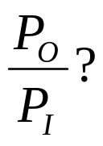
VCCS Circuit: Linear Amplifier
+

Slide 6
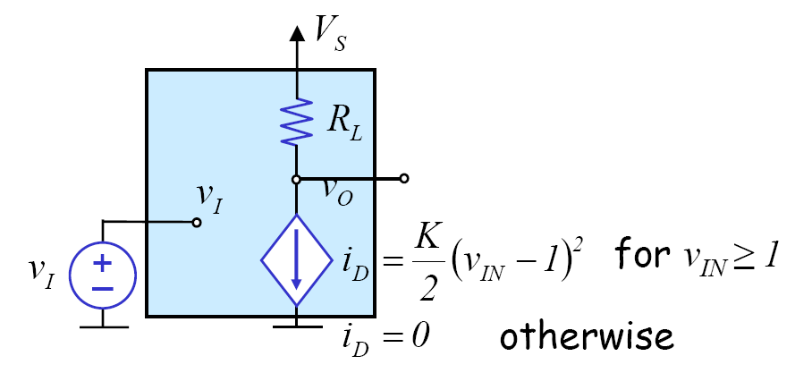

Example

Slide 7
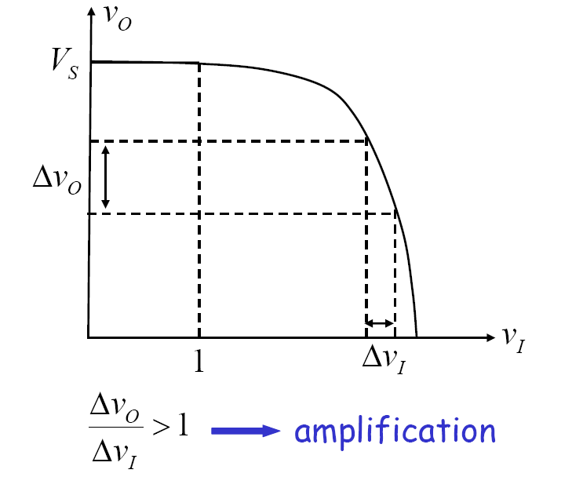
Example – cont’d

Slide 8
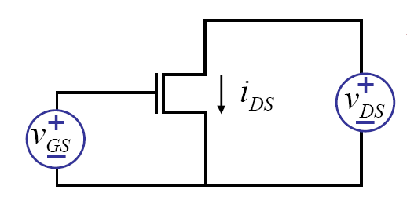
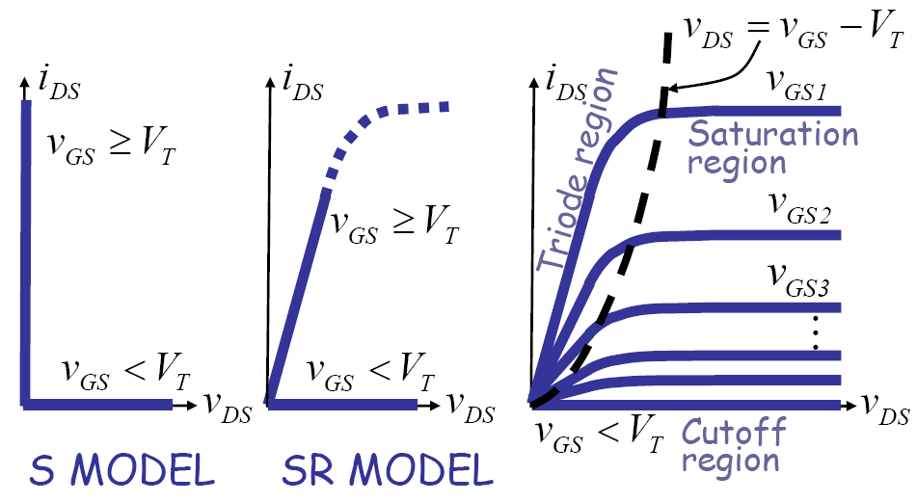
Actual MOSFET Characteristics

Slide 9
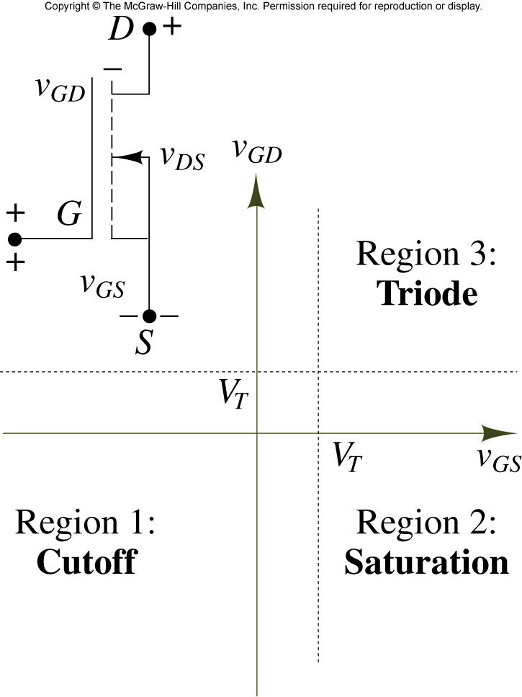
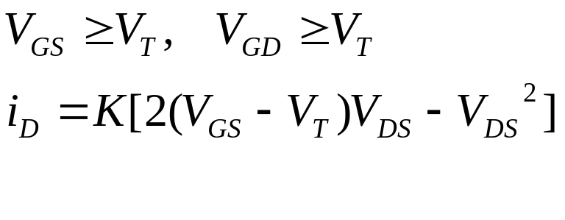
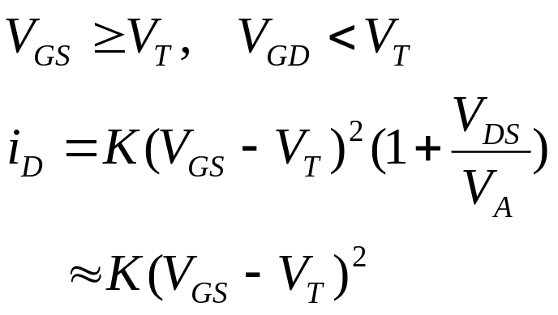
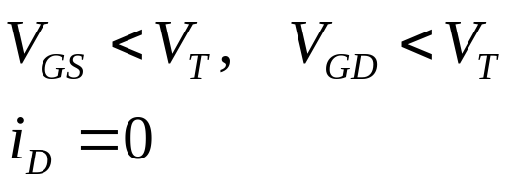
Remind: Region of Operation of NMOS

Slide 10
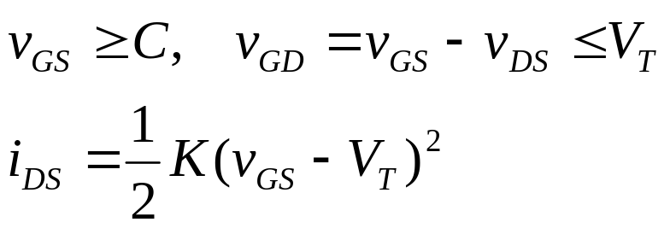
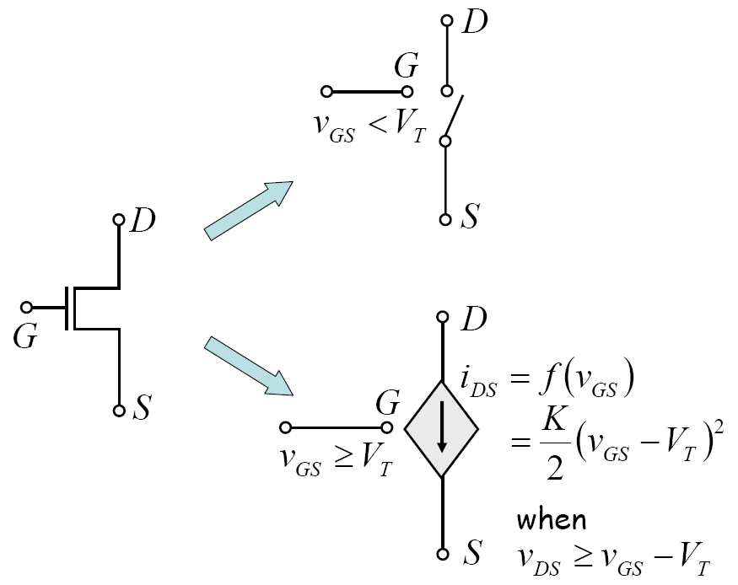
MOSFET SCS Model
SCS Model: Switched Current Source Model
  Saturation region of operation: “saturation principle”

Slide 11
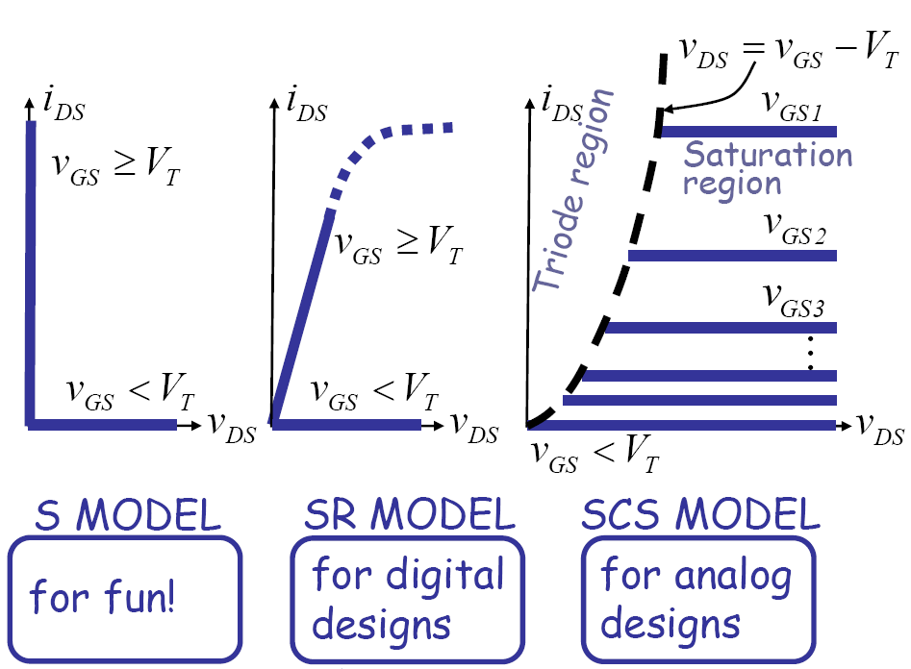
Reconciling the Models

Slide 12
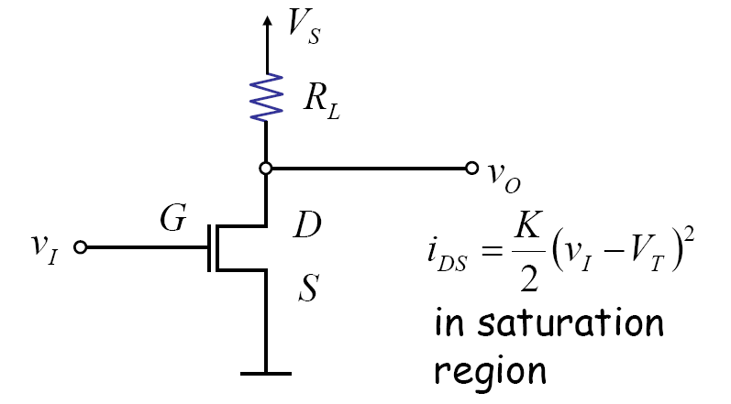
MOSFET Amplifier
What is the voltage gain?

Slide 13
Voltage Characteristics

Slide 14

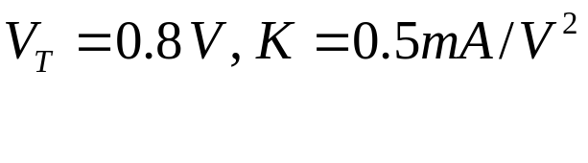


Example 7.7
+

Slide 15

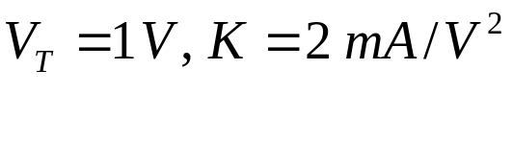


Example 7.8: Source Follower Circuit
+

Slide 16

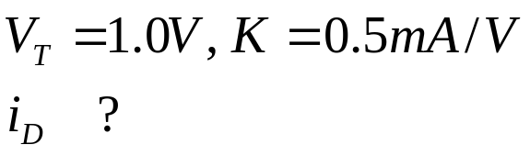



Exercise

Slide 17
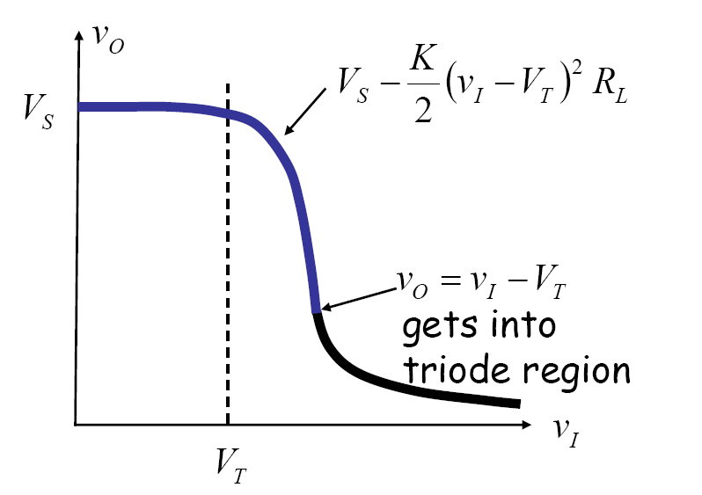





Biasing the Circuit
+
+

Slide 18

Large Signal Analysis
Relationship between
What is the range of valid input values under the saturation discipline? What is the corresponding range of output values?

Slide 19
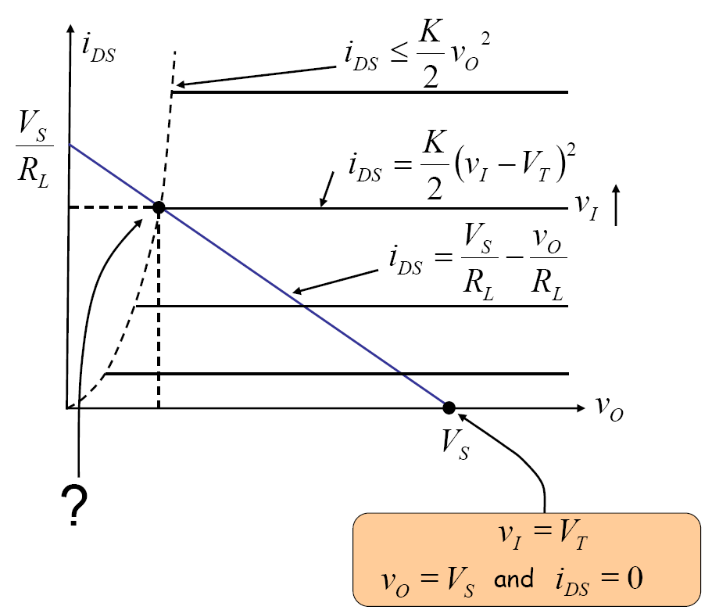
Graphical Analysis
load line

Slide 20
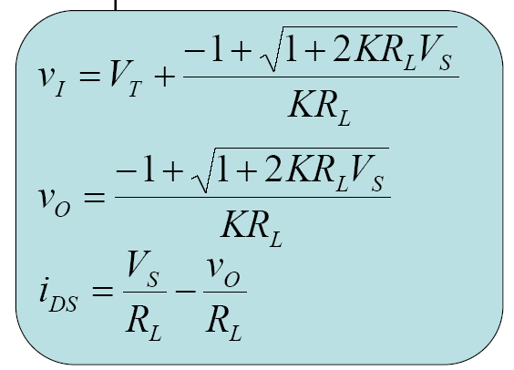

Slide 21
Example 7.10, 7.11
Valid ranges for the source follower circuit.
Operating point for maximum input swing
+

Slide 22
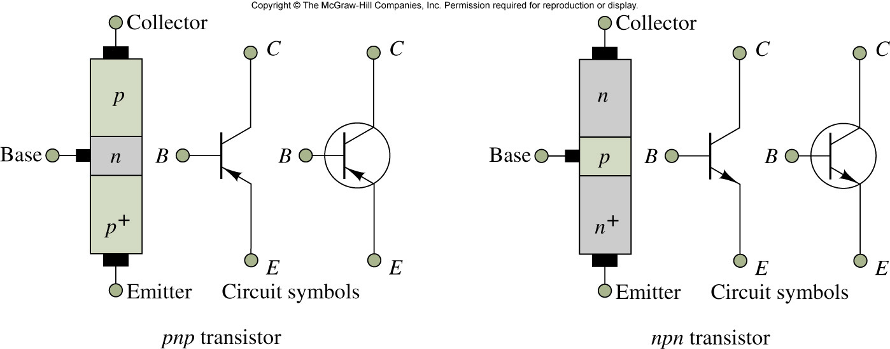
Bipolar junction transistors

Slide 23
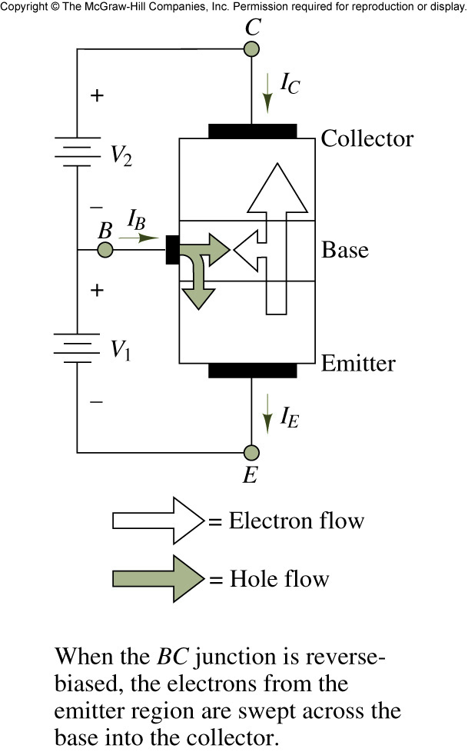
Operation Principle

Slide 24
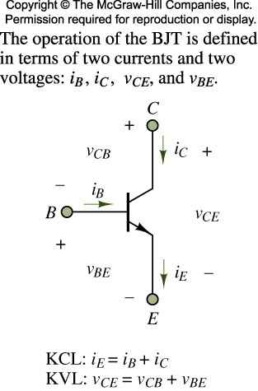

Definition of BJT voltages and currents

Slide 25
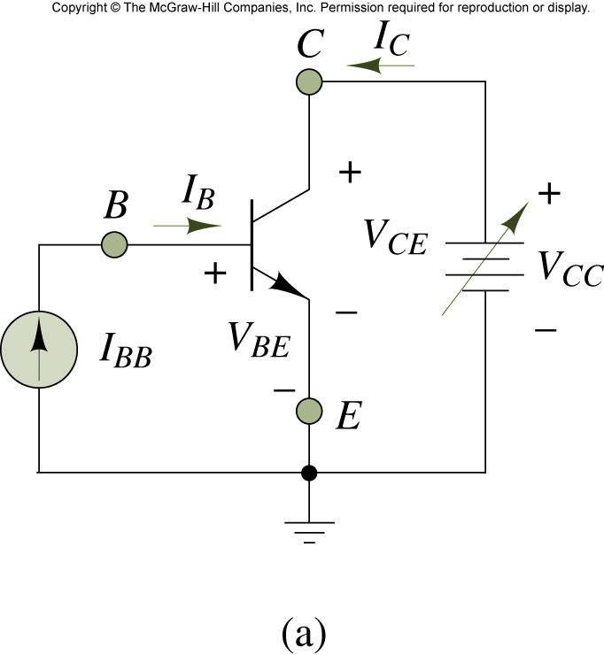
Ideal test circuit to determine the i-v characteristic

Slide 26
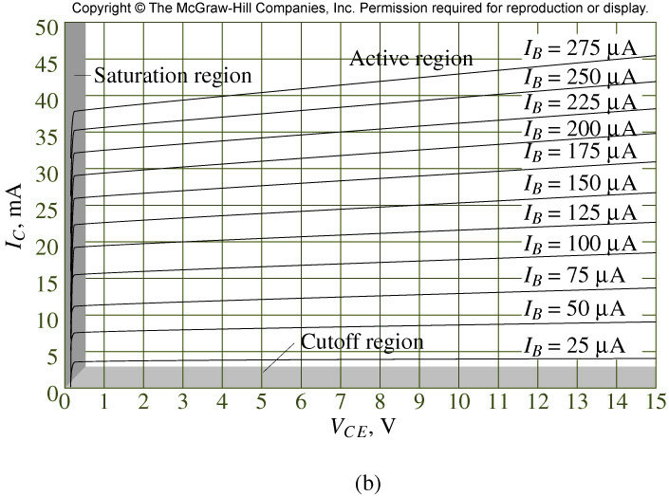
Collector-Emitter Output Characteristics
Breakdown
region
Active region
Saturation region
Cutoff region
Saturation region: V_{CE} < 0.2 , almost constant
Active region: V_{BE} = 0.6~0.7 , almost constant

Slide 27






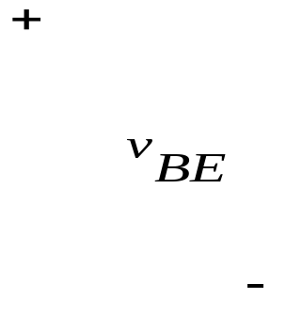


BJT Model
C
C
B
B
E
E
Piecewise-linear model

Slide 28
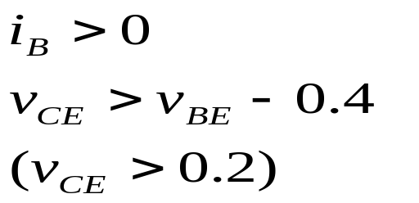
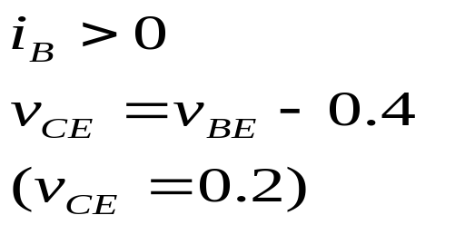
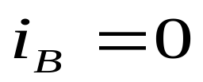
BJT Models in various regions of operation
C
C
C
B
B
E
E
E
active region
saturation region
cutoff region

Slide 29

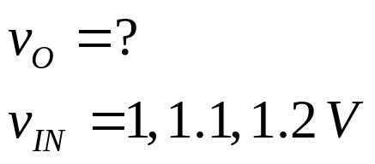

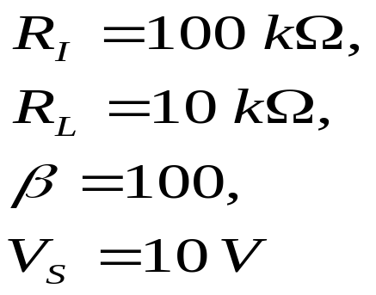
Example 7.15 BJT Amplifier
+

Slide 30
Large Signal Analysis
1. Relationship between
2. What is the range of valid input values for active region operation of the BJT ? What is the corresponding range of output values ?

Slide 31
Voltage characteristics of BJT Amplifier

Slide 33
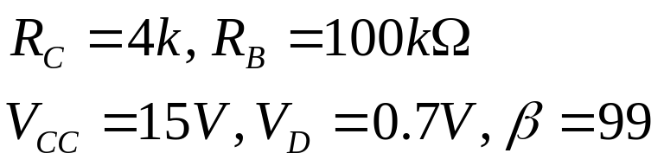


Exercise 1

Slide 34






Exercise 2: compute the bias condition

Slide 35







Example 7.19 Differential Amplifier

Slide 37
Conclusion
MOSFET Amplifier
MOSFET and SCS Model
Large Signal Analysis
BJT Amplifier
Differential Amplifier

